Slide 1
Digital Twin for Smart Factory Energy Optimization
CSE7101- Capstone Project
Review-1
Batch Number: Samsung_14
Under the Supervision of,
Dr. Robin Rohit Vincent
Professor
School of Computer Science and Engineering
Presidency University
Roll Number | Student Name
20221CSE0007 | Chandana M Rao
20221CSE0314 | Chirag BA
20221CCS0130 | Chaithra S
Name of the Program: Samsung
Name of the HoD: Dr. Robin Rohit Vincent
Name of the Program Project Coordinator: Dr.Nagaraja S R
Name of the School Project Coordinators: Dr. Sampath A K , Dr. Geetha A

Slide 2
Content
Problem Statement
Objectives
Background and Related work for title Selection
Analysis of Problem Statement
Innovation or Novel Contributions
Git-hub Link
Timeline of the Project
References

Slide 3
Problem Statement Number: Samsung_14
Organization:
Category (Hardware / Software / Both) : Software
Problem Description:
Digital Twin for Smart Factory Energy Optimization is a virtual replica of a factory that mirrors real-time operations using IoT sensors, machine data, and AI analytics to monitor and optimize energy usage. By simulating production processes, predicting energy demands, and testing optimization strategies before applying them to the physical factory, it helps reduce energy waste, lower costs, and improve sustainability without disrupting operations.

Slide 4
Objectives
Develop a real-time Digital Twin model of a smart factory’s operations.
Simulate IoT sensors and industrial protocols to generate and collect live energy usage data in a virtual environment.
Implement machine learning algorithms for energy demand forecasting.
Enable simulation of “what-if” scenarios for optimization strategies.
Reduce overall energy consumption and operational costs without affecting production.

Slide 5
Background and Related work for title Selection
Background: Smart factories leverage Industry 4.0 technologies such as IoT, AI, and cloud computing to improve operational efficiency. Energy optimization is critical for sustainability and cost reduction.
Related Work:
Siemens and GE have implemented Digital Twin models for predictive maintenance and energy management.
Research studies show Digital Twins can improve energy efficiency by 10–20% in manufacturing environments.
Gaps exist in scalable, real-time optimization models that are adaptable to varying production schedules and machinery.
Title Justification: The title reflects the integration of a Digital Twin framework with a targeted application in energy optimization, directly addressing operational inefficiencies in modern factories.

Slide 6
Innovation or Novel Contributions
Real-time Digital Twin specifically tailored for energy optimization in smart factories.
Integration of IoT-based monitoring with predictive AI models for dynamic energy management.
Scenario-based simulation for risk-free optimization testing before real-world application.
Modular architecture allowing deployment across different factory setups and scales.
Potential integration with renewable energy sources for carbon footprint reduction.

Slide 7
Analysis of Problem Statement
Technology Stack Components:
1. Data Acquisition and Processing (Simulated)
Virtual Data Generation: Software-based components to simulate real-time data streams on energy consumption, machine status, and environmental factors. This replaces physical IoT sensors with a virtual data source.
Edge Computing (Virtual): A software layer to simulate local processing and filtering of data before it is sent to a central server, mimicking the functions of edge devices in a physical factory.
2. Digital Twin and Simulation
3D Modeling Software: Tools for creating a virtual, photorealistic replica of the factory layout and machinery.
Simulation Engine: A software platform to run simulations of the factory’s operational processes, energy flows, and various scenarios to test and validate hypotheses.
3. Analytics and Optimization
Machine Learning Frameworks: Libraries and tools to develop and train models for forecasting energy demand, identifying anomalies, and optimizing consumption within the simulated environment.
AI/ML Models: Pre-built models for predictive analytics, such as forecasting energy demands and suggesting optimal operational schedules based on simulated data.

Slide 8
Analysis of Problem Statement
Technology Stack Components:
4. User Interface and Visualization
Dashboarding Tools: Software for creating dashboards that visualize simulated real-time energy usage, simulation results, and optimization recommendations.
API Gateway: A system to manage and secure communication between the different virtual components and other potential third-party software systems.

Slide 9
Analysis of Problem Statement (contd...)
Software Requirements:
  Operating System: A compatible OS for the server and edge devices (e.g., Linux, Windows Server).
  Programming Languages: Languages like Python for data analysis, machine learning, and backend logic, along with JavaScript for the frontend.
  Database: A time-series database (e.g., InfluxDB) and a relational database (e.g., PostgreSQL) for storing configuration and metadata.
  Data Visualization Libraries: Tools like D3.js or Plotly for creating interactive dashboards.
  Cloud Services: Platform as a Service (PaaS) and Infrastructure as a Service (IaaS) offerings from a cloud provider for scalability and management.

Slide 10
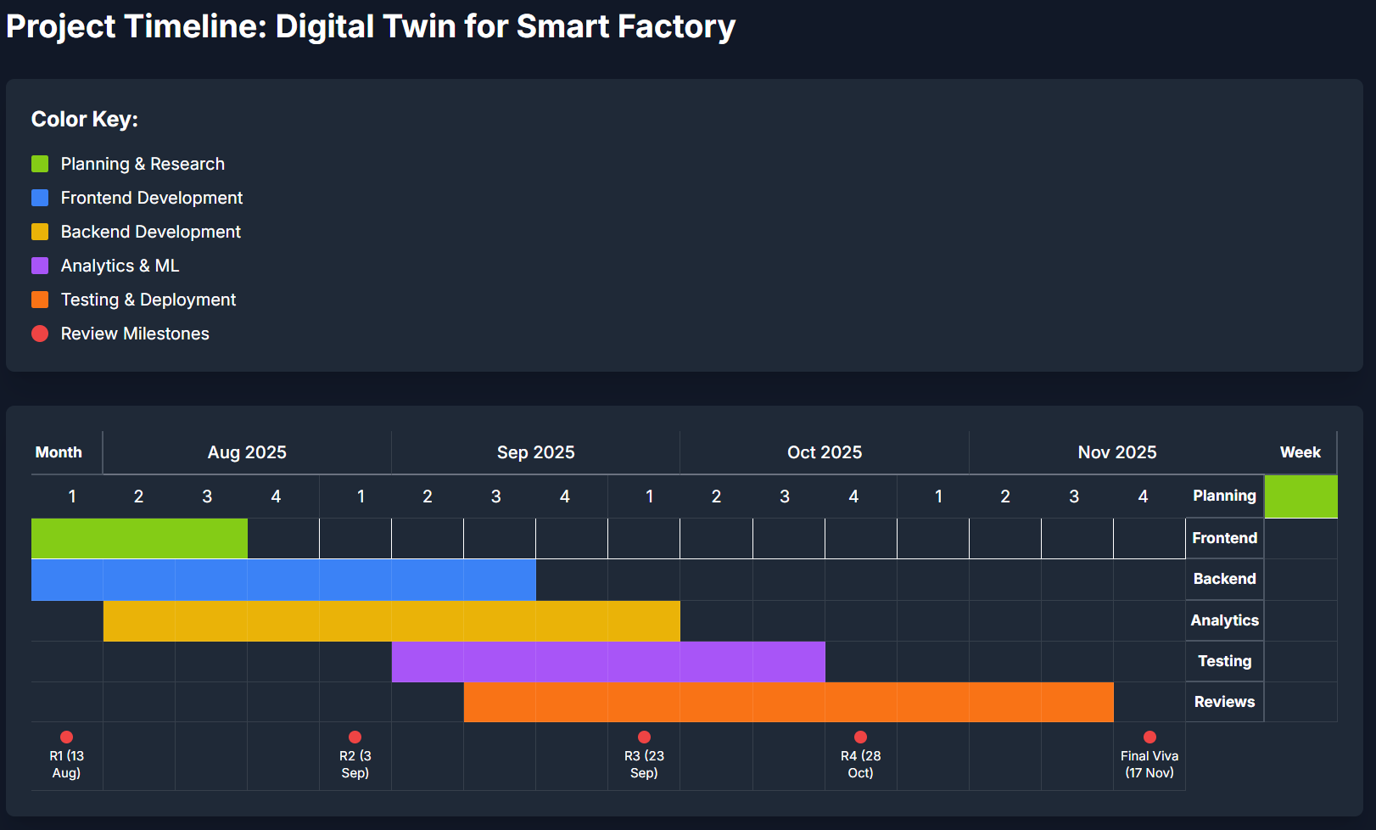
Timeline of the Project (Gantt Chart)

Slide 11
Github Link
The Github link provided should have public access permission.
Github Link

Slide 12
References (IEEE Paper format)
[1] M. Grieves and J. Vickers, “Digital Twin: Mitigating Unpredictable, Undesirable Emergent Behavior in Complex Systems,” in Transdisciplinary Perspectives on Complex Systems, Springer, 2017.
[2] F. Tao, Q. Qi, L. Wang, and A. Y. C. Nee, “Digital Twins and Cyber–Physical Systems toward Smart Manufacturing and Industry 4.0: Correlation and Comparison,” Engineering, 2019.
[3] IEC, IEC 62832-1:2020 Digital Factory—General principles, 2020 (official PDF excerpt).
[4] OPC Foundation, “OPC UA—Interoperability for Industrie 4.0 and IoT (IEC 62541),” brochure, 2023.
[5] J. V. S. do Amaral et al., “Energy Digital Twin applications: A review,” Renewable and Sustainable Energy Reviews, 2023.
[6] N. Mohamed, S. Lazarova-Molnar, and J. Al-Jaroodi, “Digital Twins for Energy-Efficient Manufacturing,” IEEE SysCon, 2023.
[7] E. Cagno et al., “Energy management and Industry 4.0: Analysis of the digital transformation of energy efficiency programs,” Applied Energy, 2025.
[8] S. Lazarova-Molnar, A. Bilali, and L. Chelbi, “A Vision for Advancing Digital Twins Intelligence,” VISIGRAPP/SCITEPRESS, 2024.
[9] T. Xia et al., “Digital twin-based real-time energy optimization method for production line considering fault disturbances,” Journal of Intelligent Manufacturing, 2025.
[10] A. Billey and T. Wuest, “Energy Digital Twins in Smart Manufacturing Systems,” Robotics and Computer-Integrated Manufacturing, 2024 (heating tunnel case).
[11] A. Khdoudi et al., “A Deep-Reinforcement-Learning-Based Digital Twin for Manufacturing Process Optimization,” Systems, 2024.
[12] D. Bousnina and G. Guerassimoff, “Optimal energy management in smart energy systems: A deep reinforcement learning approach and a digital twin case-study,” Smart Energy, 2024.
[13] G. Rolofs et al., “Integrating Digital Twins and Cyber-Physical Systems for Flexible Energy Management in Manufacturing Facilities: A Conceptual Framework,” Electronics, 2024.
[14] M. Soori et al., “Digital twin for smart manufacturing: A review,” Journal of Manufacturing Systems, 2023.
[15] D. Vance et al., “Next-Level Energy Management in Manufacturing: Facility-Level Energy Digital Twin Framework Based on Machine Learning and Automated Data Collection,” Energies, 2025.

Slide 13


